Slide 1
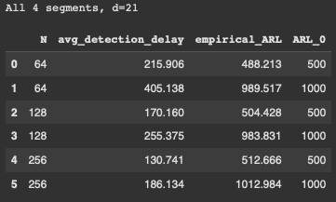
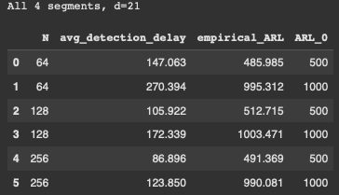
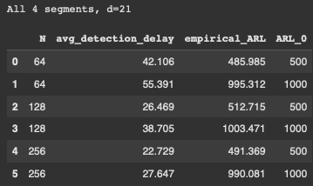
Small Change
Medium Change
Big Change

Slide 2
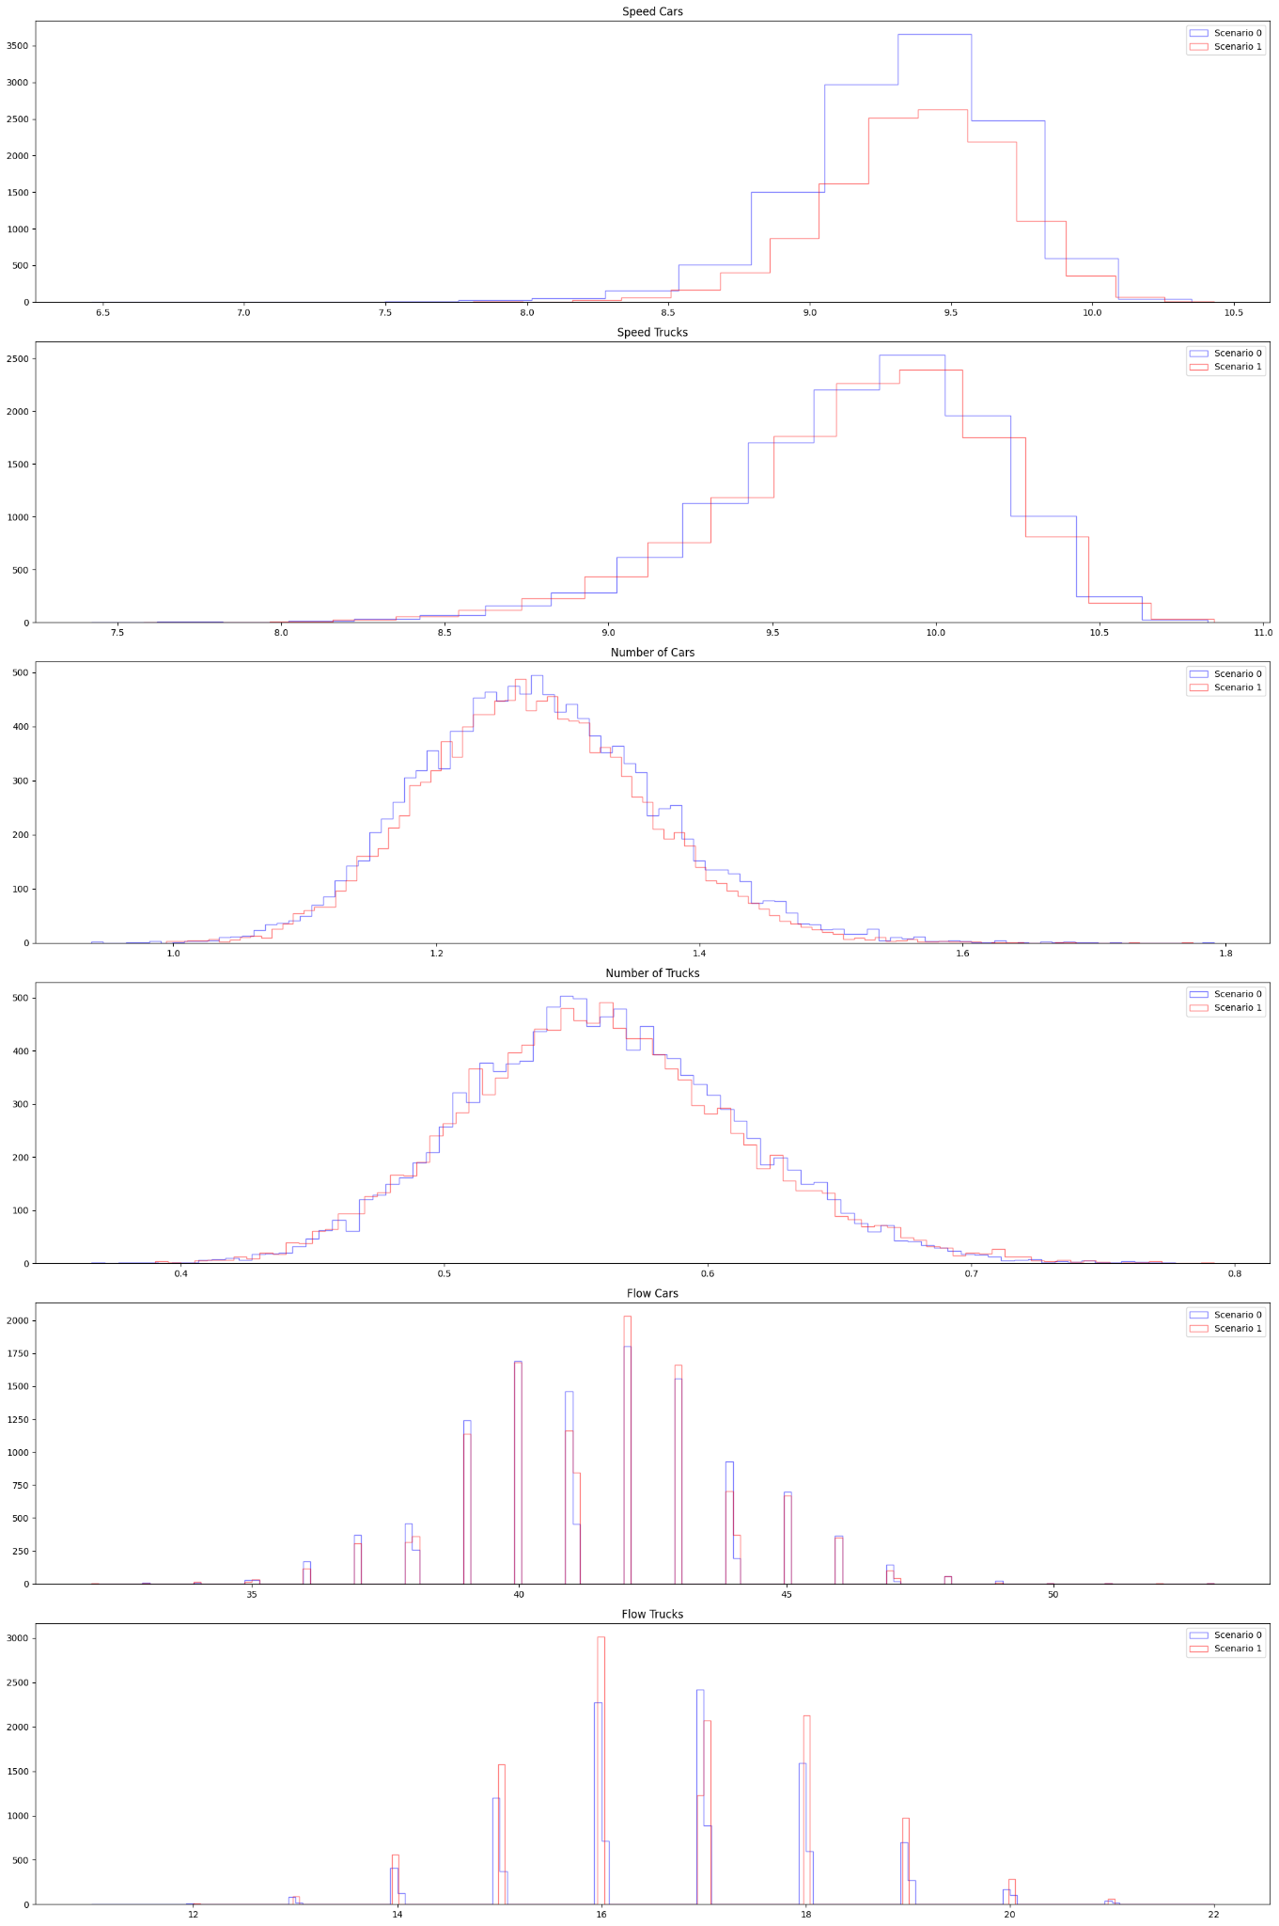
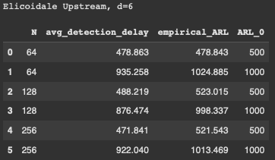
Small Change | Elicoidale Upstream (d=6), qtree ewma (K=32)
No change detected on this segment.

Slide 3
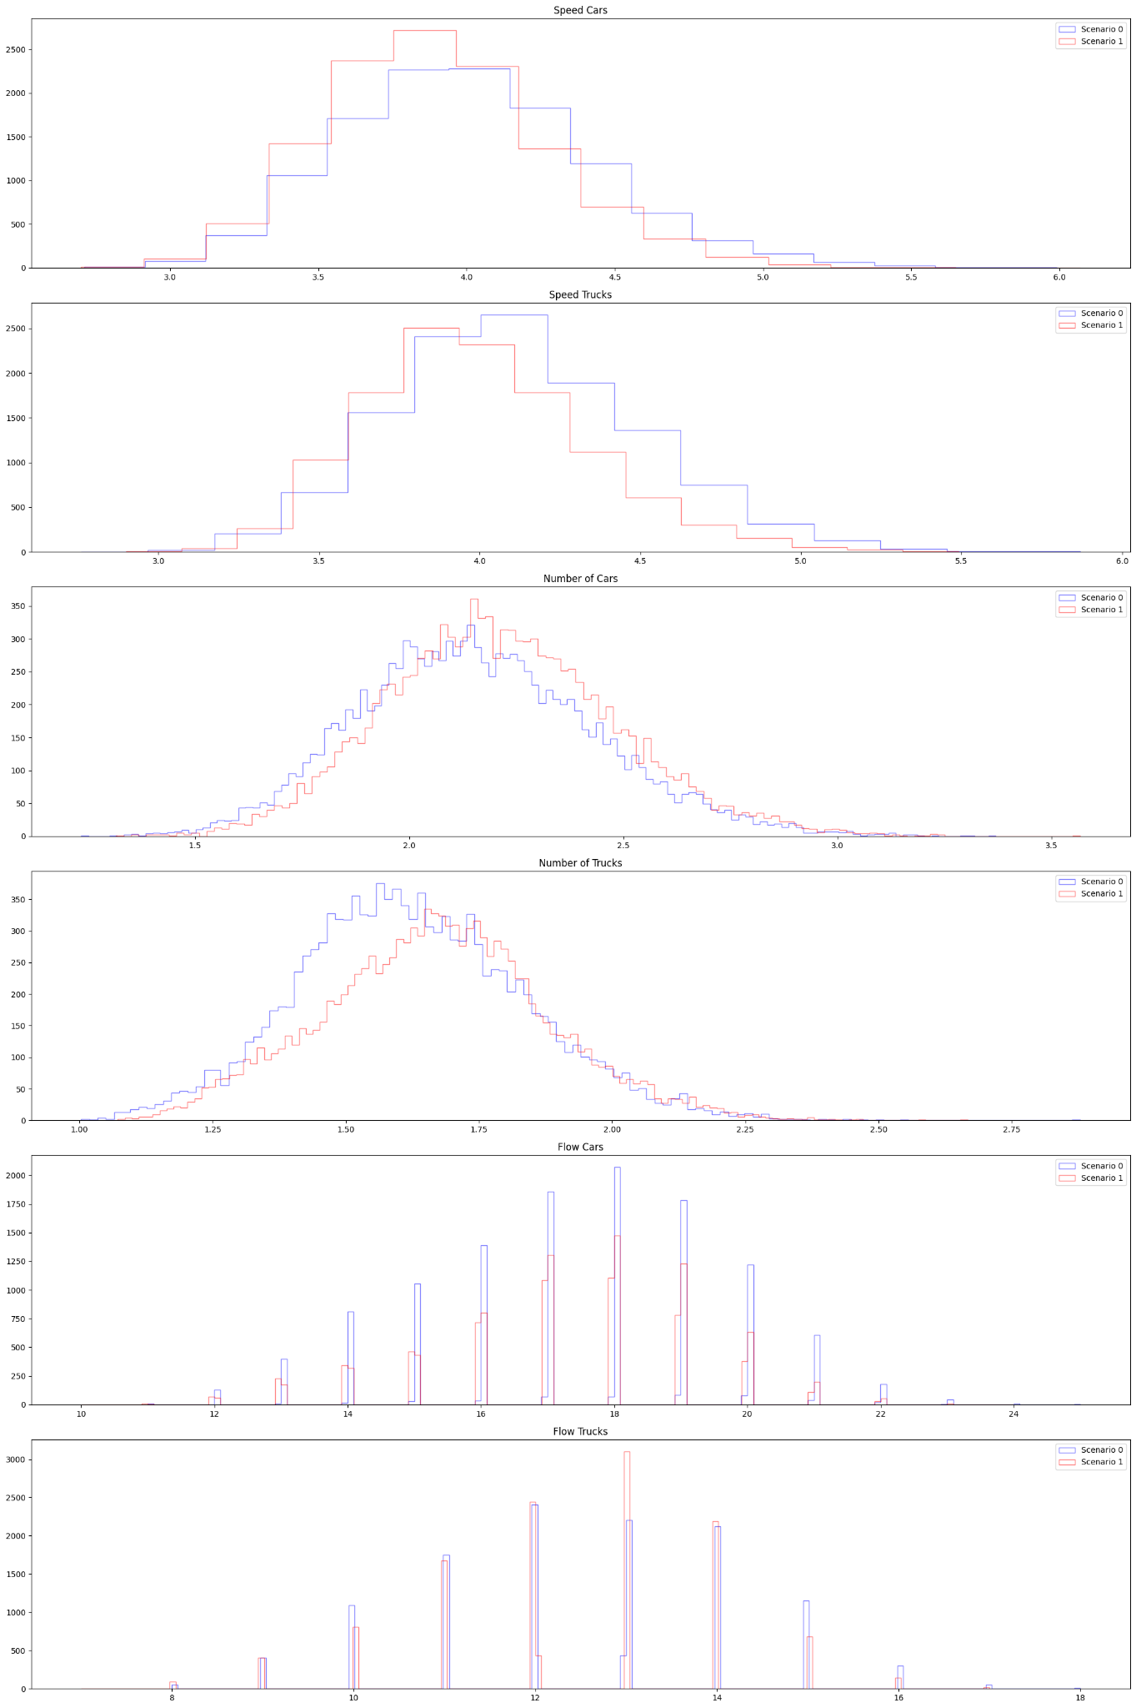
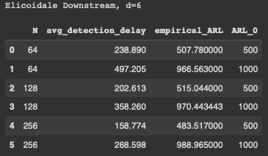
Small Change | Elicoidale Downstream (d=6), qtree ewma (K=32)
No change detected here?

Slide 4
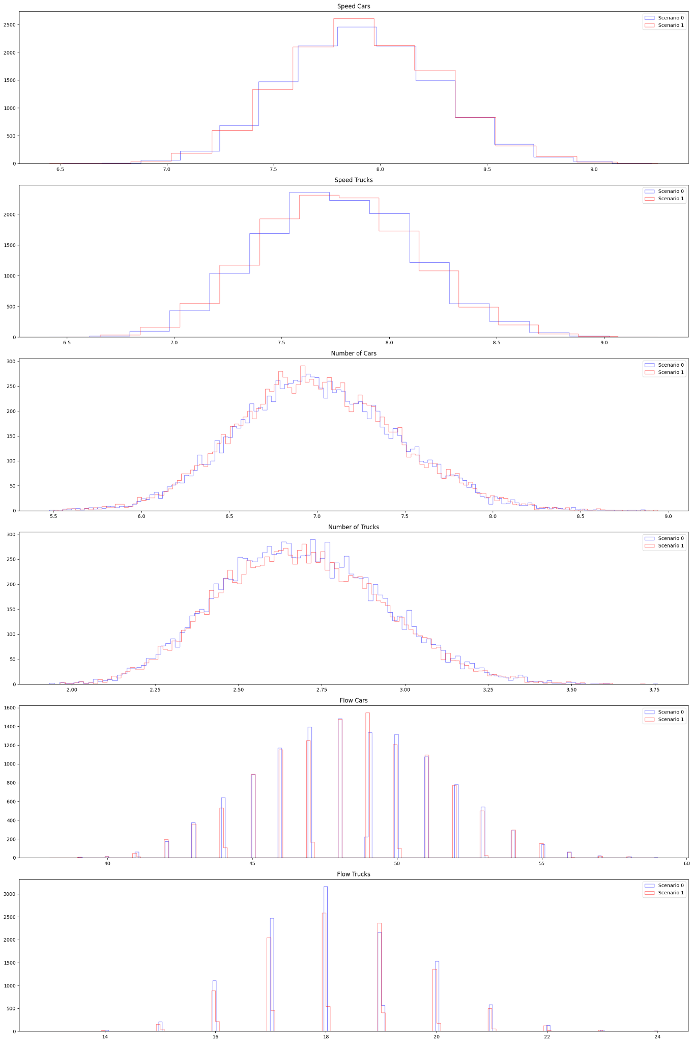
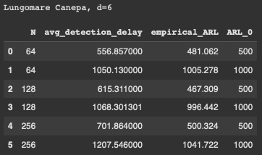
Small Change | Lungomare Canepa (d=6), qtree ewma (K=32)
No change detected on this segment.

Slide 5
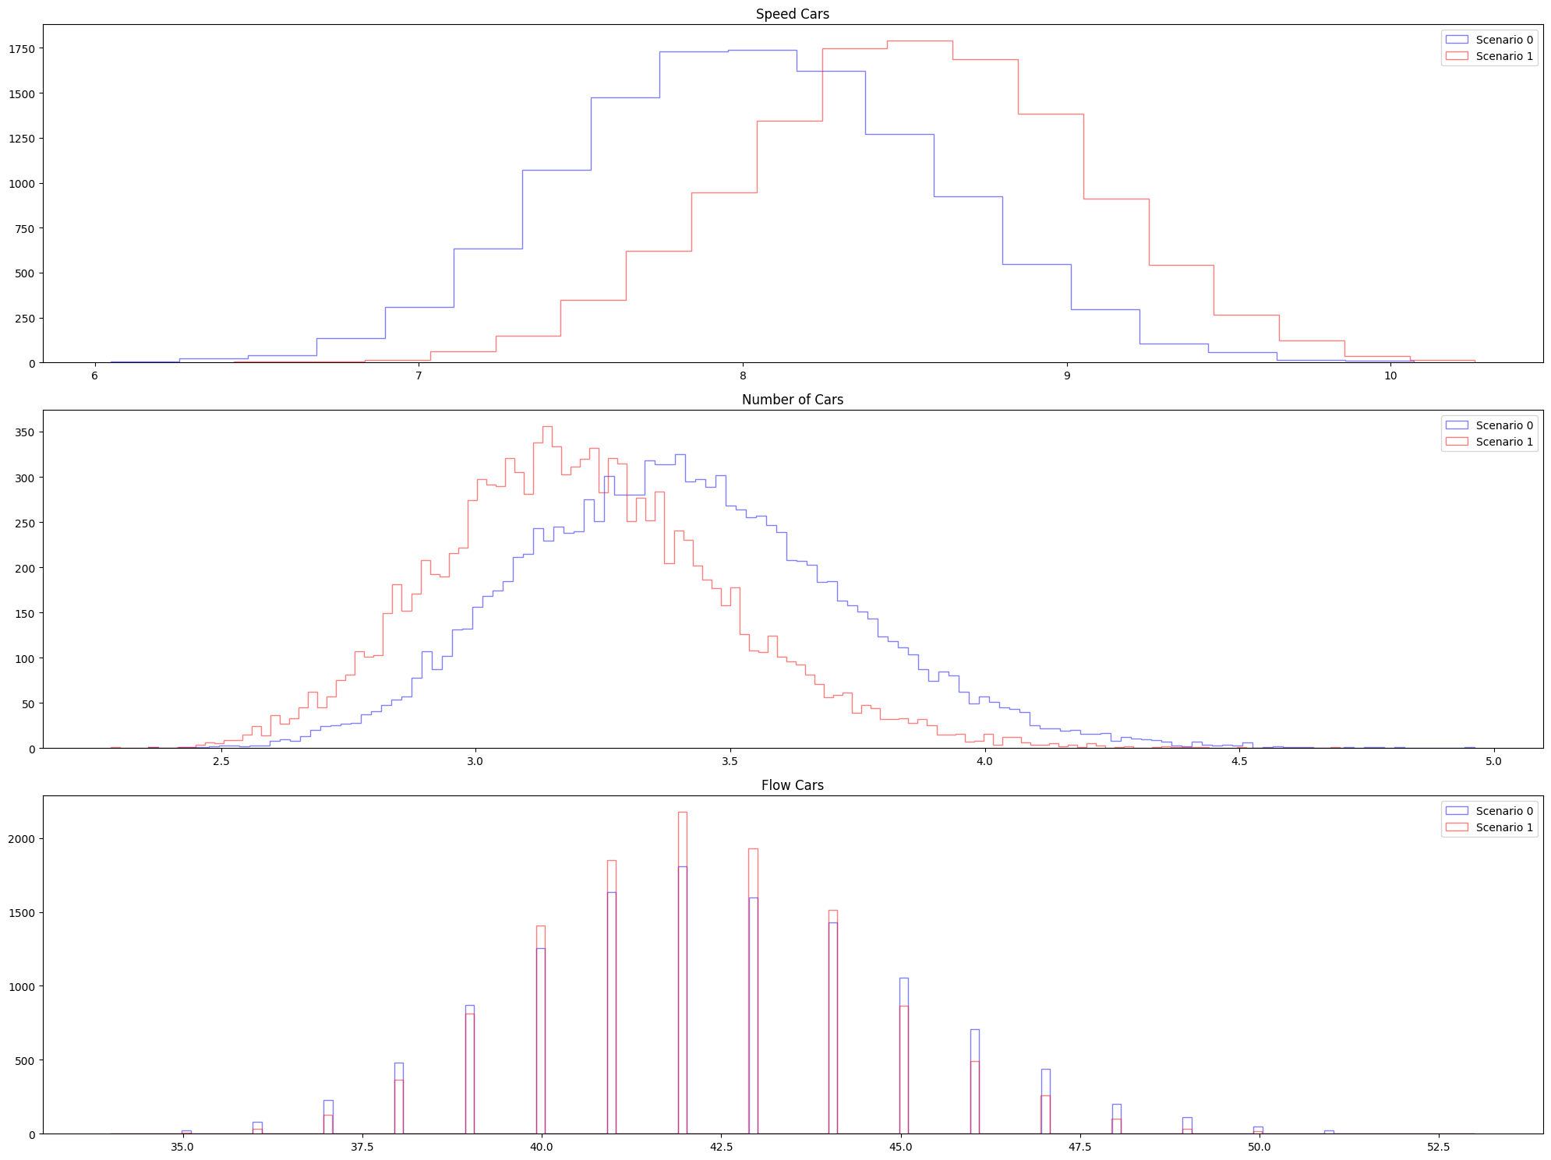
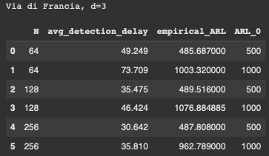
Small Change | Via di Francia (d=3), qtree ewma (K=32)
Even if the change was minimal, it might have affected this segment. Here it is being detected in around 1 to 2 months.

Slide 6
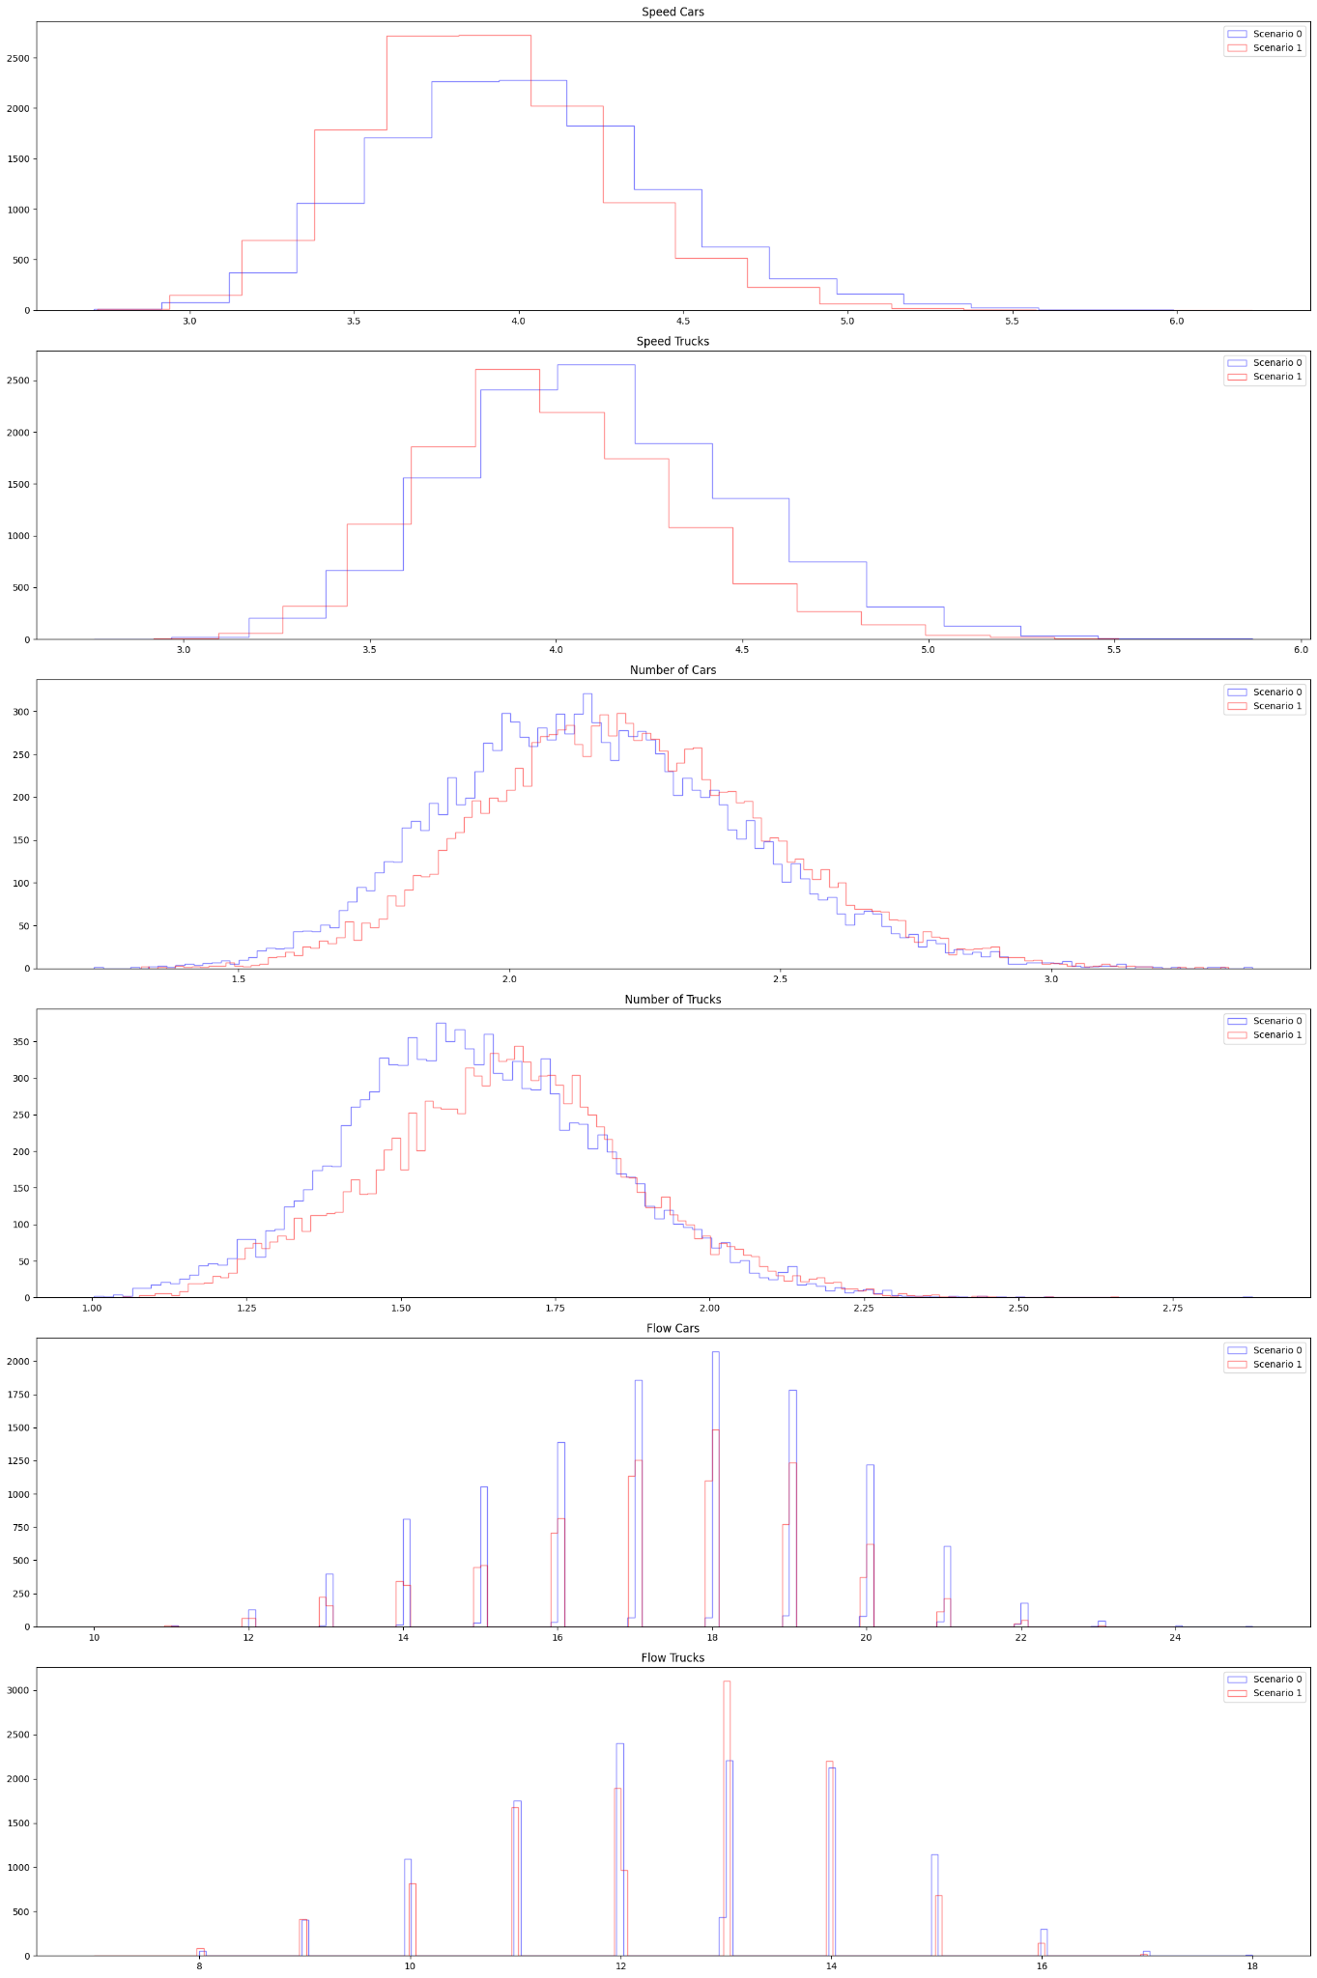
Medium Change | All 4 segments (d=21), qtree ewma (K=32)
Change detected around 5 months later. Do we consider it a detection?

Slide 7
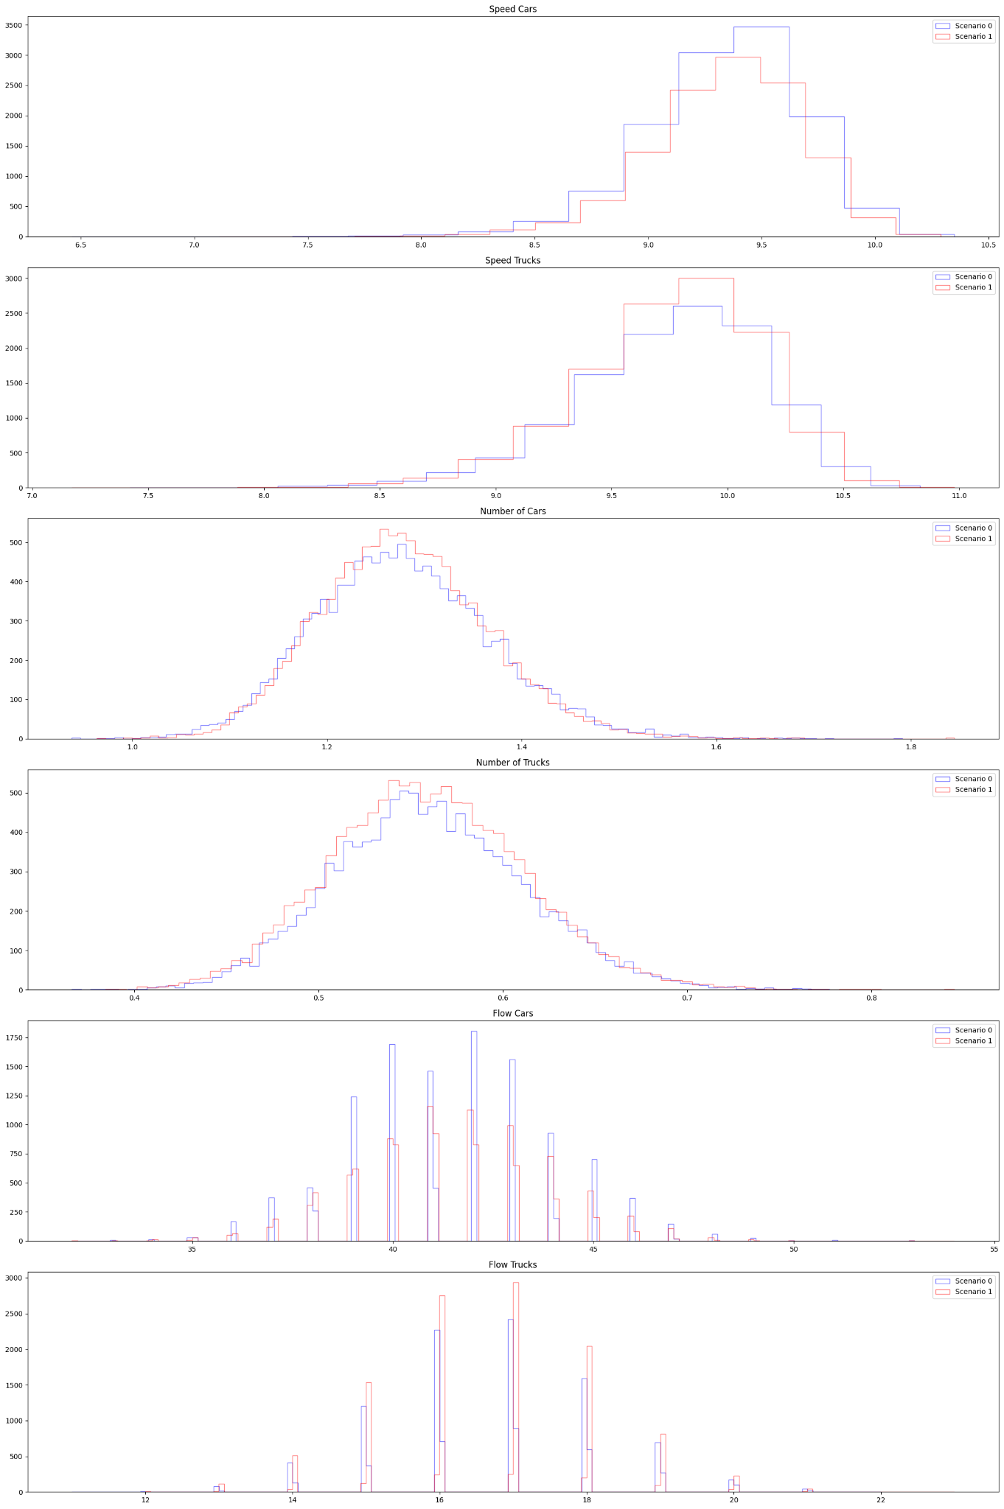
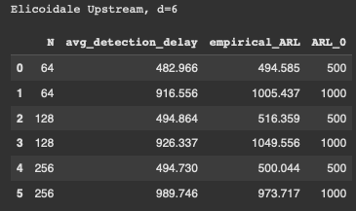
Medium Change | Elicoidale Upstream (d=6), qtree ewma (K=32)
No change detected here.

Slide 8
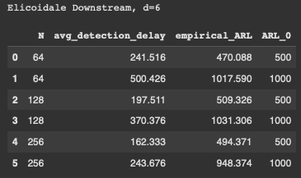
Medium Change | Elicoidale Downstream (d=6), qtree ewma (K=32)
No change detected here?

Slide 9
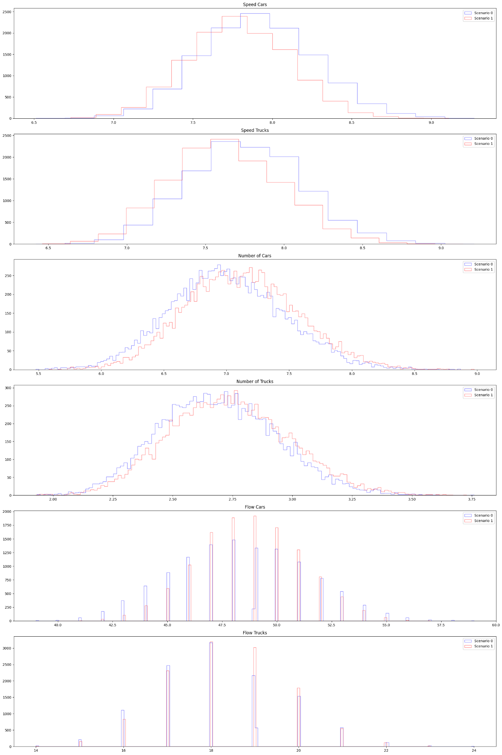
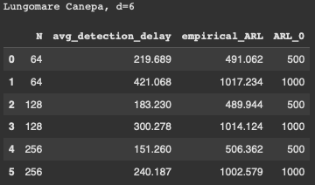
Medium Change | Lungomare Canepa (d=6), qtree ewma (K=32)
No change detected here?

Slide 10
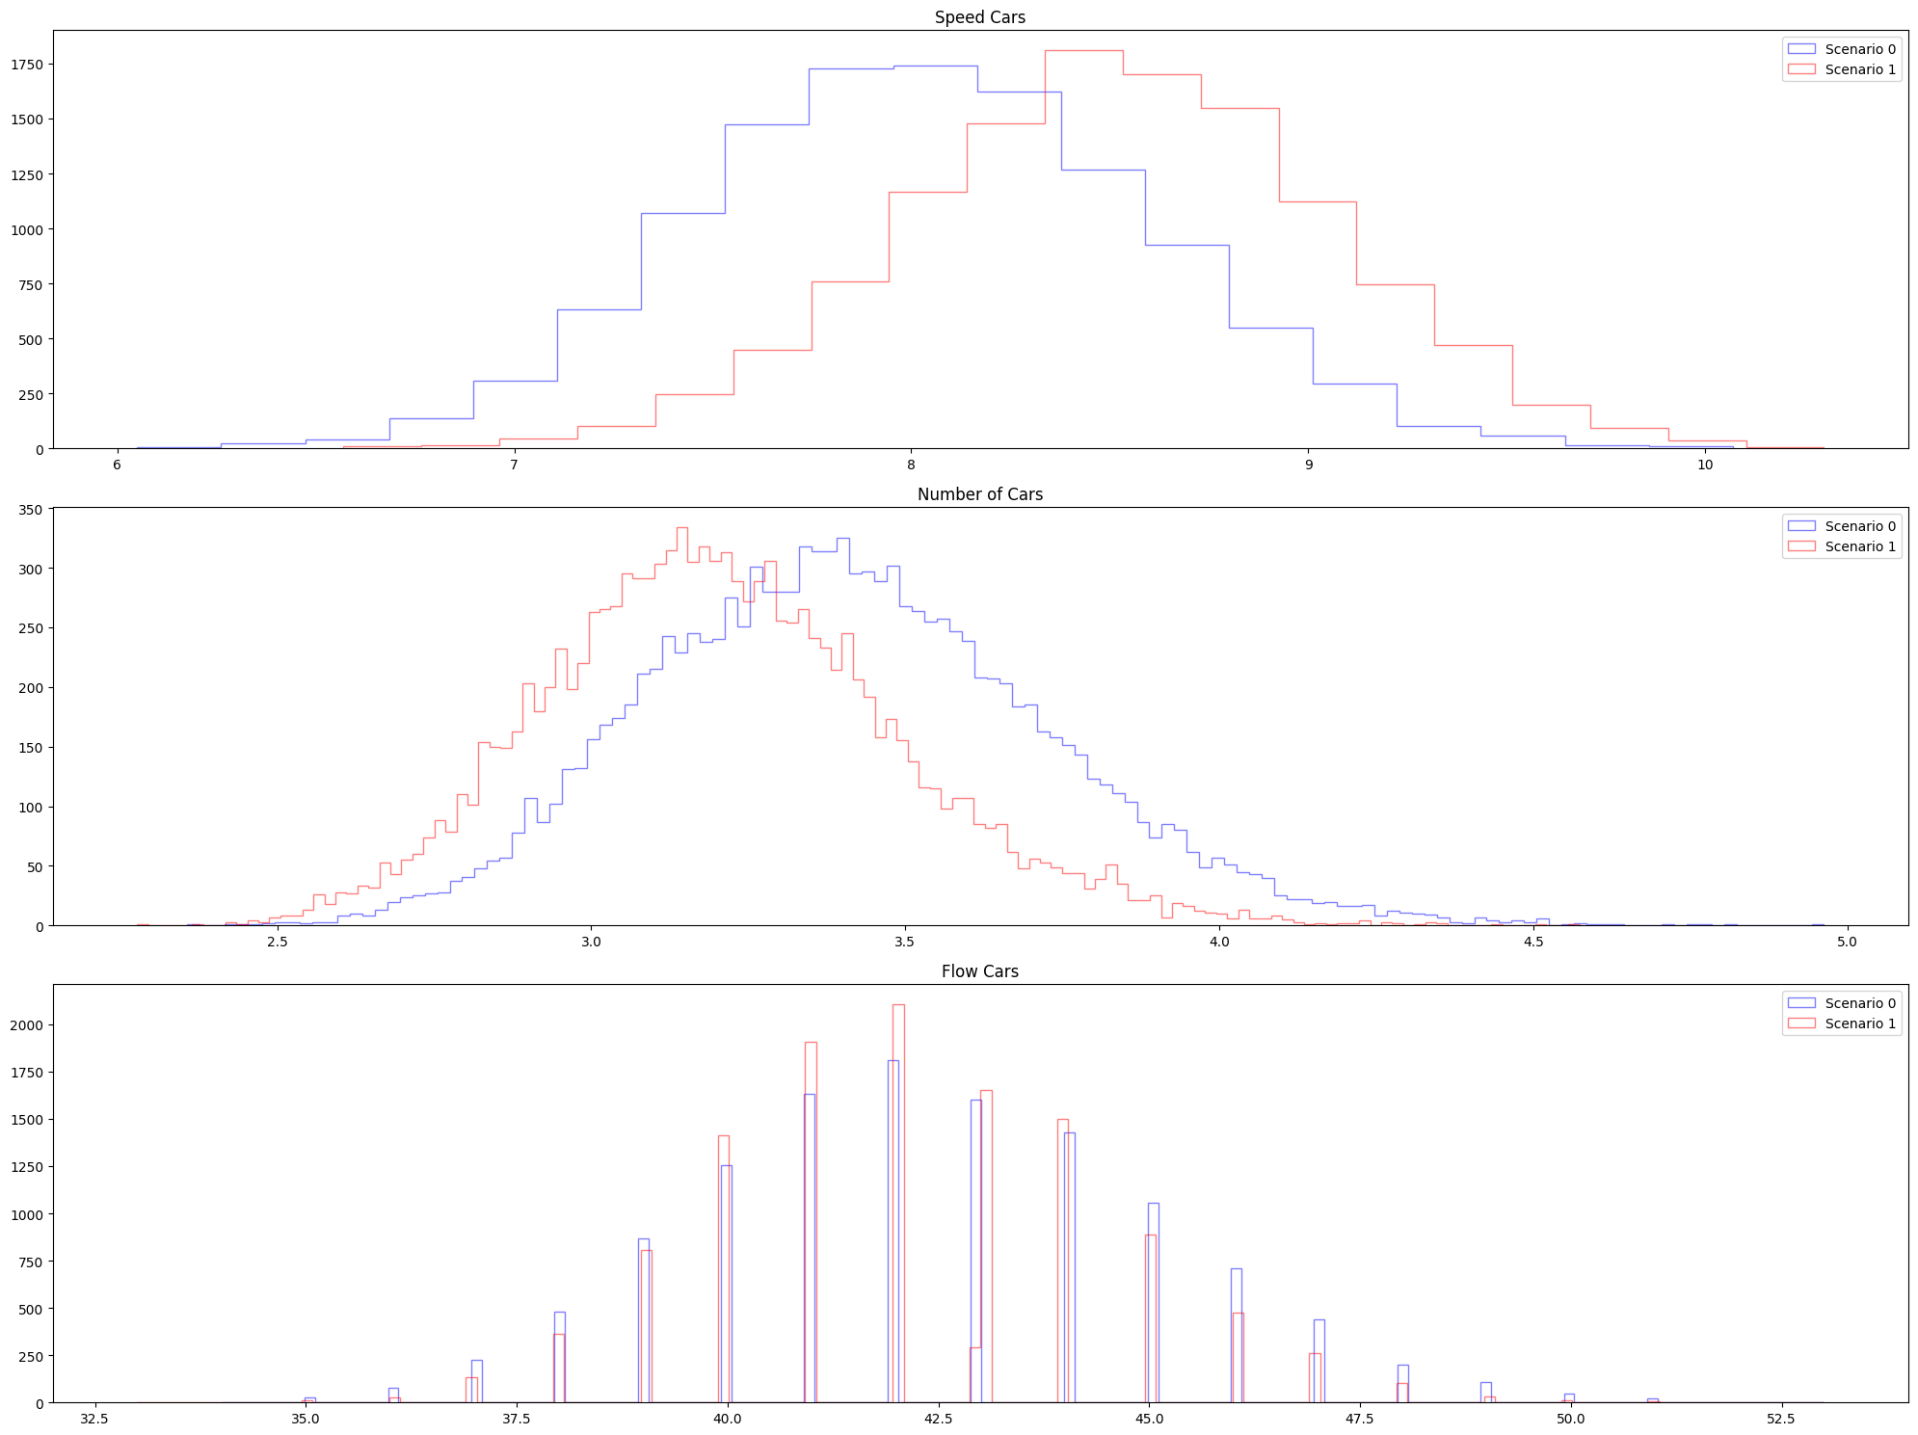
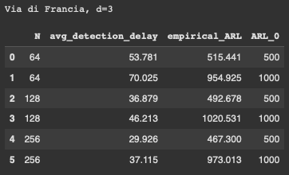
Medium Change | Via di Francia (d=3), qtree ewma (K=32)
Change detected around 2 months later.

Slide 11
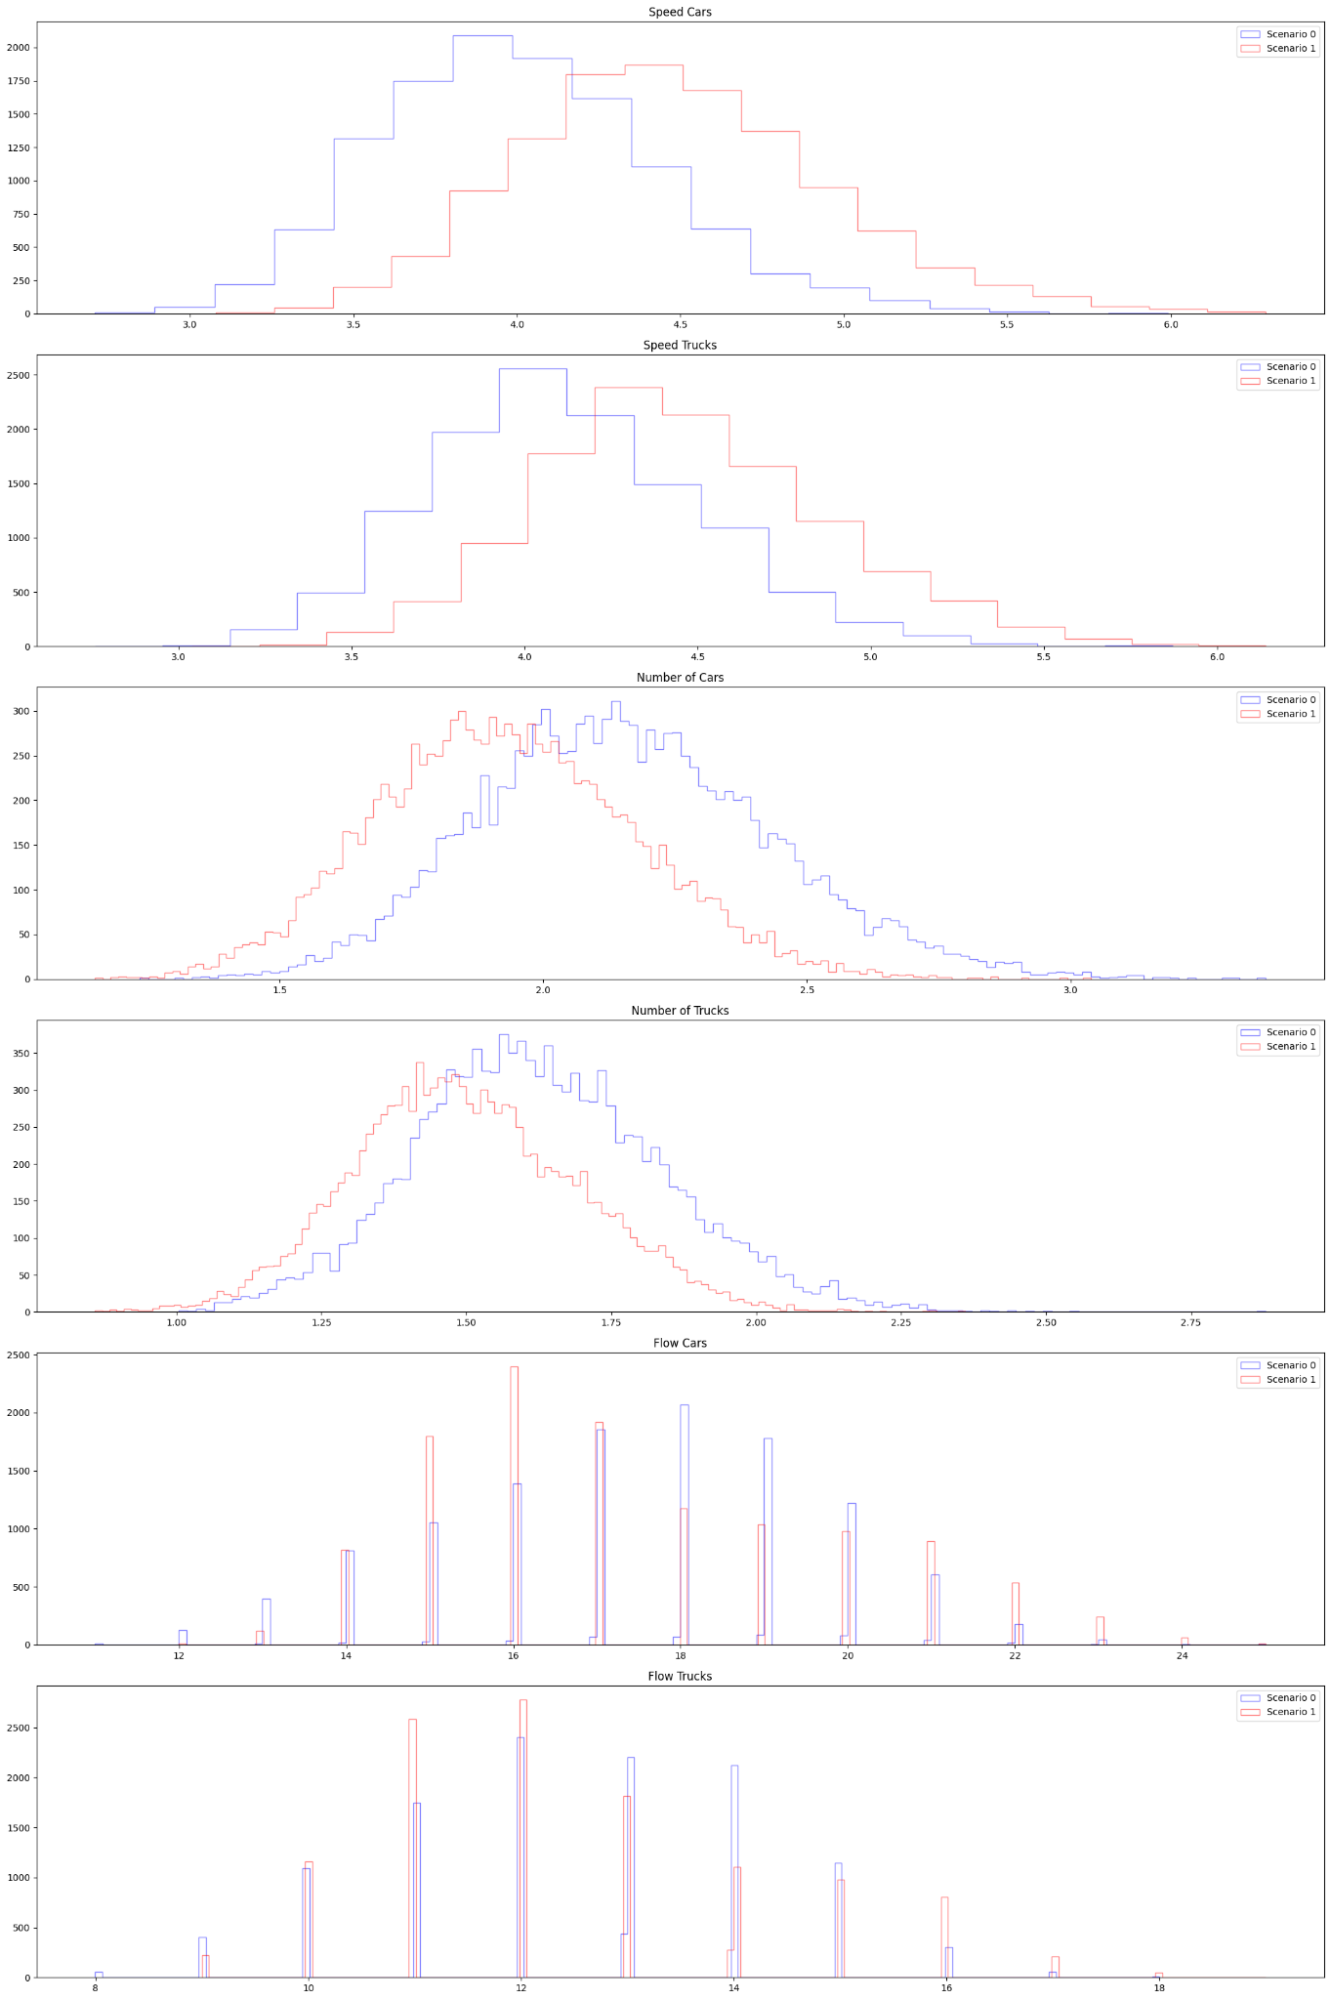
Big Change | All 4 segments (d=21), qtree ewma (K=32)
Change detected around 1 months later.

Slide 12
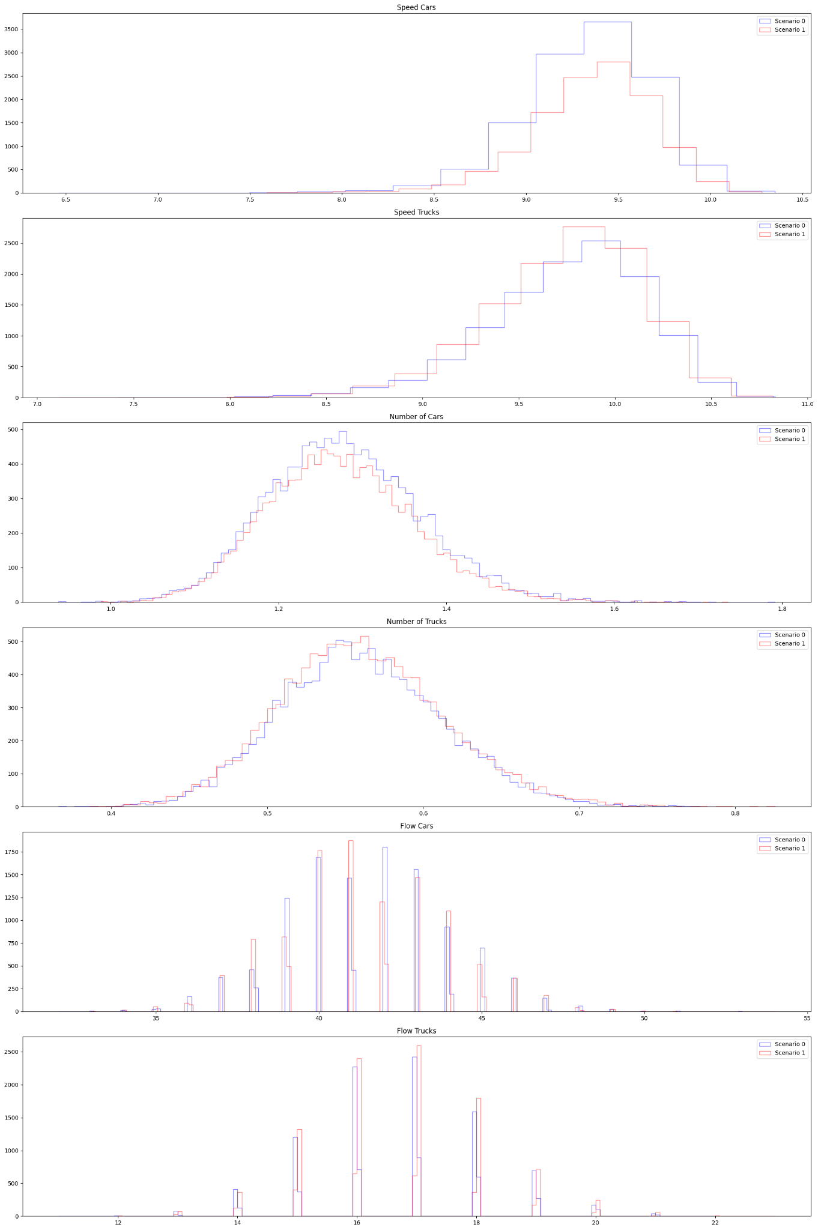
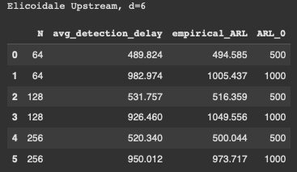
Big Change | Elicoidale Upstream (d=6), qtree ewma (K=32)
No change detected.

Slide 13
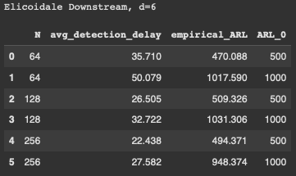
Big Change | Elicoidale Downstream (d=6), qtree ewma (K=32)
Change detected around 1 month later.

Slide 14
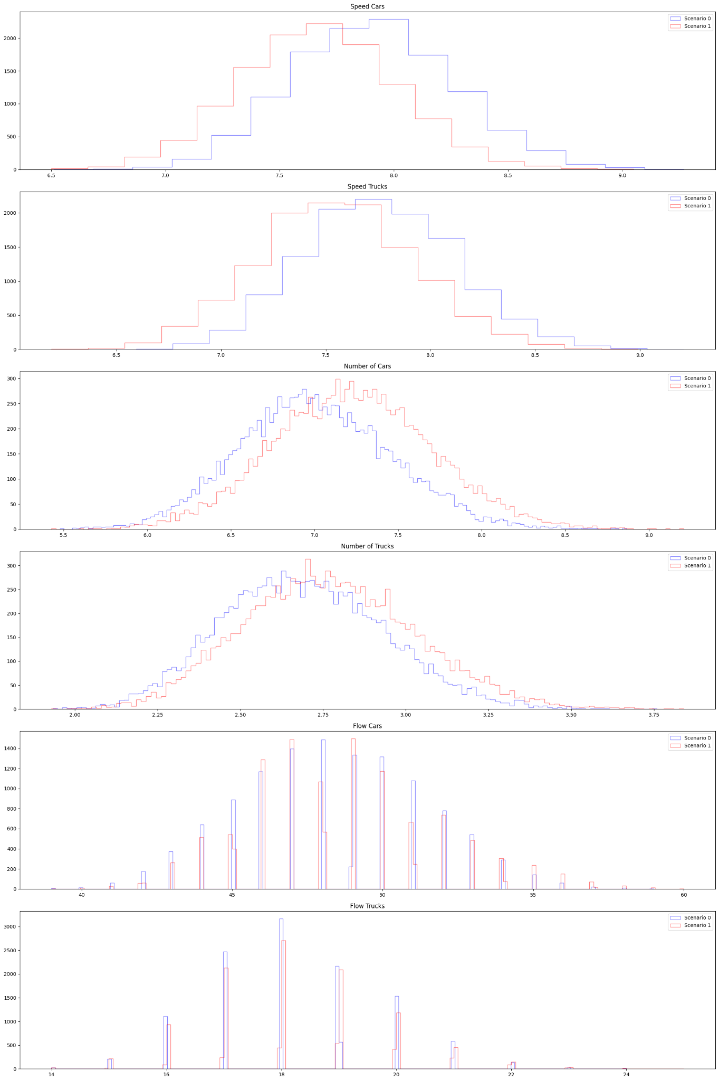
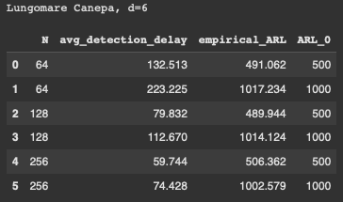
Big Change | Lungomare Canepa (d=6), qtree ewma (K=32)
Change detected around 2-3 months later.

Slide 15
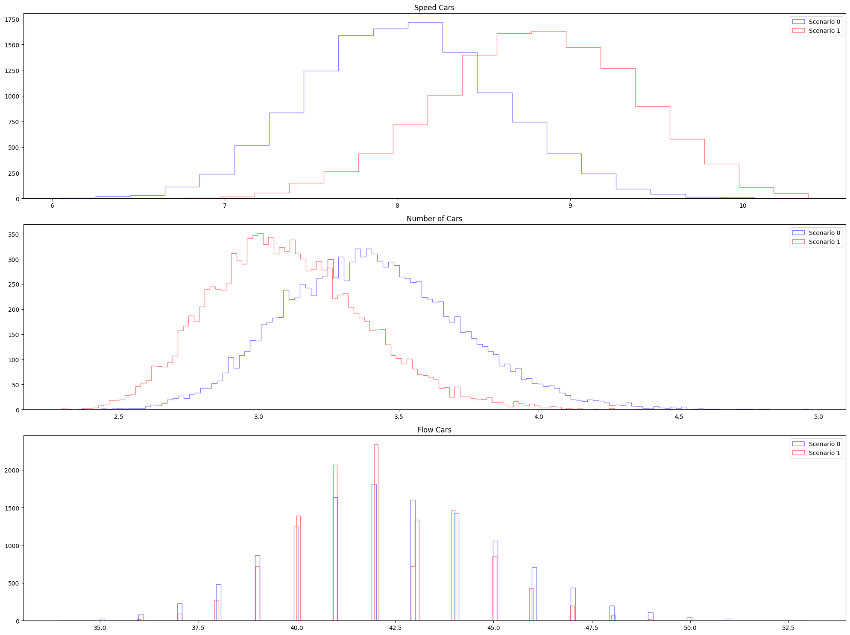
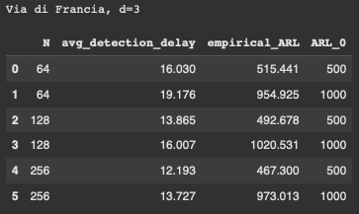
Big Change | Via di Francia (d=3), qtree ewma (K=32)
Change detected around 2 weeks later, really easy to detect here.

